Slide 1
Sterling E-Commerce Customer Behavior Analysis
6th Grade

Slide 2
Table of contents
01
02
03
04
Data Understanding
Business Understanding
Identify metric and data composition
Identifying problem statement and KPIs
Data Preparation
Data Visualization
Cleaning, Pivot table
Identifying trends and customer behavior

Slide 3
Introduction
Sterling E-Commerce is a leading online shopping platform offering a wide variety of high-quality products across categories such as fashion, health, electronics, and home essentials, committed to delivering a seamless shopping experience focused on quality, affordability, and convenience. Sterling E-Commerce caters to a diverse customer base.
This project aims to understand the purchasing patterns and preferences of our customers by analyzing key factors like customer demographics, shopping habits, and product trends. The project will provide insights to optimize marketing strategies, improve customer satisfaction, and enhance the overall shopping experience.

Slide 4
Business Understanding

Slide 5
Problem Statement
Sterling E-Commerce wants to answer the following questions.
How can we better understand customer preferences?
How can we enhance overall customer experience and boost efficiency?
How can we improve product offerings and streamline operations.
KPIs
Sterling E-Commerce wants to measure:
Customer demographics and preferences.
Purchase frequency and spending habits.
Popular product categories and trends.
Factors influencing customer loyalty and repeat purchases.

Slide 6
Data Understanding

Slide 7

Total Transaction
283,084
Metrics
Category, City, County, Customer ID, Customer since, Date of order, Full name, Gender, Item ID, Order ID, Payment method, Place name, Reference No, Region, State, Username, Zip Code, Quantity ordered, Total sales.

Slide 8
Data Preparation

Slide 9


The data was cleaned using the following formats:
Find and replace
Date formatting

Slide 10
Data Visualization

Slide 11
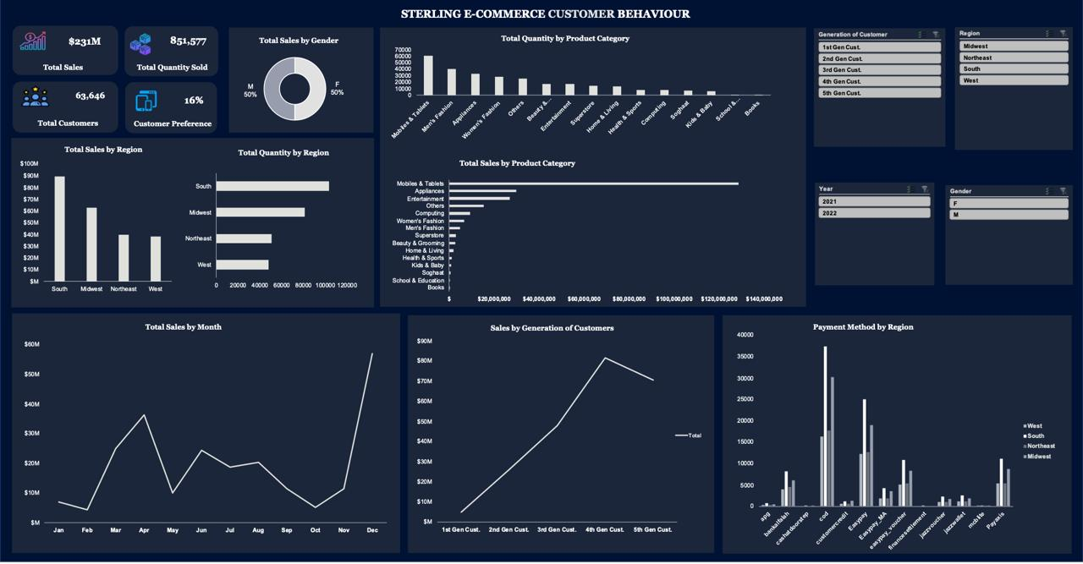
123,000
Numbers unfold as a canvas of infinite potential

Slide 12
Insights
The South region is the largest contributor to sales, accounting for approximately 39% of total revenue. In contrast, the North-East and West regions represent the lowest sales, each contributing 17% to overall sales.
The Mobile & Tablet category is a dominant revenue driver, representing 16% of the total product quantity purchased and contributing an impressive 56% of total sales. On the other hand, categories like Soghaat, School & Education, and Books account for the smallest shares, contributing 0.25%, 0.05%, and 0.01%, respectively.
December 2021 emerged as the peak sales month, generating 25% of total sales, while October 2021 and February 2022 saw the lowest sales, each contributing just 2%.
The 4th generation customers (born between 2005 and 2013) outperformed other generations in terms of sales, contributing significantly more to the company’s revenue."

Slide 13
Recommendations
Increase investment in the Mobile & Tablets category within the South region, as it has demonstrated significant sales potential and strong customer demand.
Perform a detailed analysis of the North-East and West regions to uncover the factors contributing to their underperformance. Consider adjusting marketing strategies by optimizing product promotions, expanding product availability, and enhancing distribution channels to boost sales in these areas.
Develop targeted product promotion campaigns for Soghaat, School & Education, and Books to drive awareness and increase sales in these underperforming categories.
Launch a Customer Rewards Program aimed at improving customer retention by incentivizing repeat purchases and enhancing customer loyalty.
Investigate the sales decline in October 2021 and February 2022 by conducting a comprehensive market survey, along with in-depth analysis of customer feedback, Sales Executive performance, and customer service interactions to identify the root causes and implement corrective measures.

Slide 14


Slide 15




Group 1 FSDS Aug 2024

Slide 16
Thanks!

